Slide 1


Data Analysis

Slide 2


Today's agenda
Project recap
Problem
The Analytics team
Process
Insights
Summary

Slide 3

Web Social is a fast growing technology unicorn that need to adapt quickly to its global scale.
Accenture has begun a 3 month POC focusing on these tasks
An audit of Web Social’s big data practice
Recommendations for a successful IPO
Analysis to find Web Social’s top 5 most popular categories of content
Project Recap

Slide 4


Problem
Over 500 million active users per month
Over 100,000 posts per day, leading to:
Over 35,600,000 pieces of content per year.
How to manage the challenges of big data.
Analysis of Web Social’s content categories to highlights the top 5 most populaer categories of content

Slide 5



Sarah Jimmy
Chief Technical Architect
The Analytics team
Michael Rash
Senior Principle
Gabriel Oni
Data Analyst

Slide 6
Process
1
Data Understanding
2
Data Cleaning
3
Data Modeling
4
Data Analysis
5
Uncover Insights

Slide 7

Insights
16
UNIQUE
CATEGORIES
1897
REACTIONS TO “ANIMAL” POSTS
MONDAY
DAY WITH MOST POSTS
MAY
MONTH WITH MOST POSTS

Slide 8
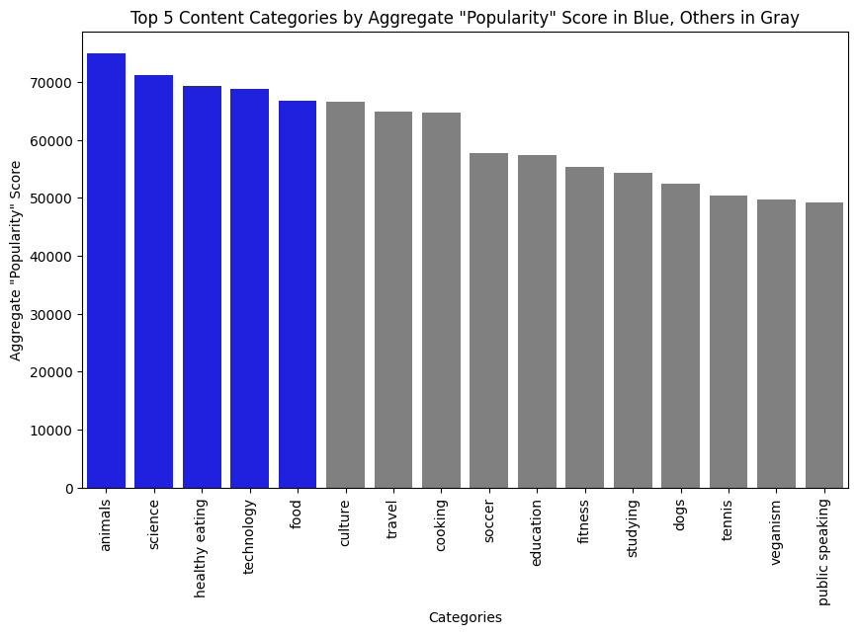

Slide 9
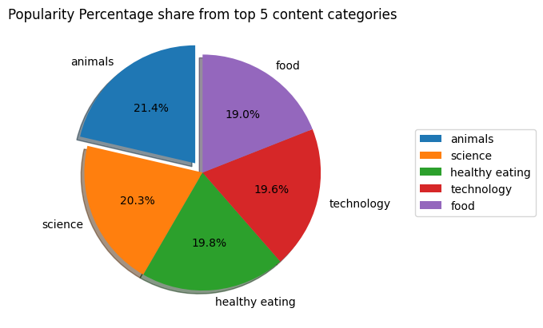

Slide 10

ANALYSIS
Animals and Science are the two most popular content categories, showing that people enjoy contents centred around "life" and "knowledge" the most.
INSIGHT
Users reacted most to contents posted in the month of May and on Modays. This may give insight into the particular posts that interested them the most and be used to improve on content creation, to increase user engagement.
NEXT STEPS
This ad-hoc analysis is insightful and can be put into use to further test how well it improves your business. We can show you how to do this.
Summary

Slide 11

Thank you!
ANY QUESTIONS?

